Slide 1
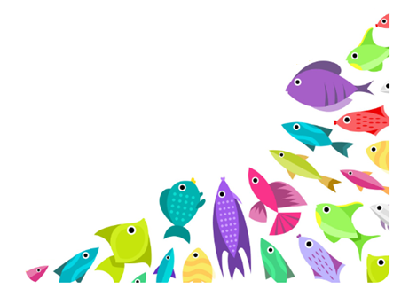
Fish Classification through Deep Learning
Catch & Classify
Presenter
Geetha Palanisamy
MDTM46B

Slide 2
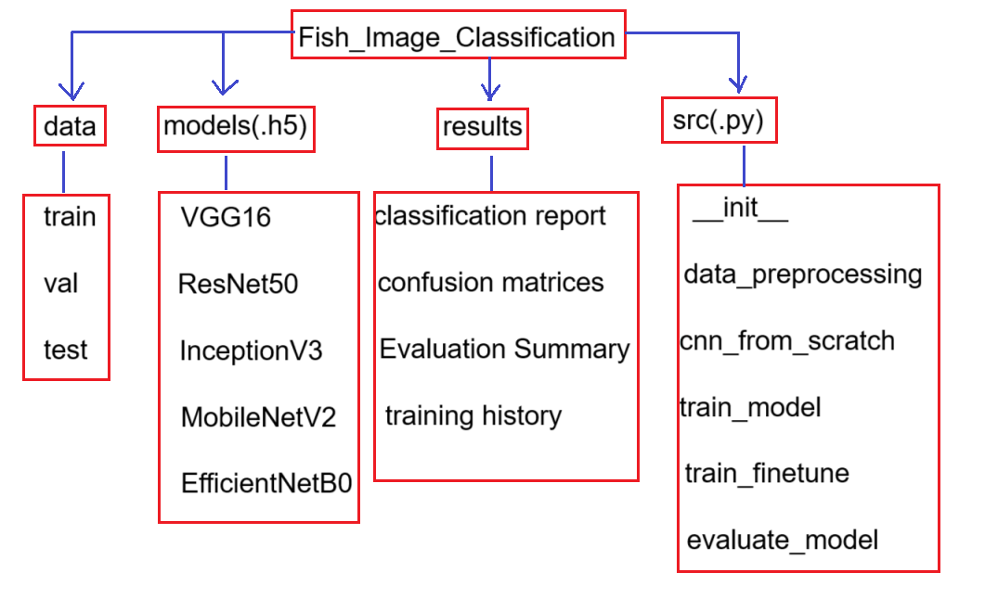
PROJECT OVERVIEW
Objective:
To develop an intelligent system capable of classifying multiple fish species using deep learning models.
Key Goals:
Automate species recognition from fish images
Compare performance of five CNN architectures
Deploy the best model through a Streamlit web interface
Tech Stack: Python| Streamlit | Tensorflow | Keras
Project Structure

Slide 3
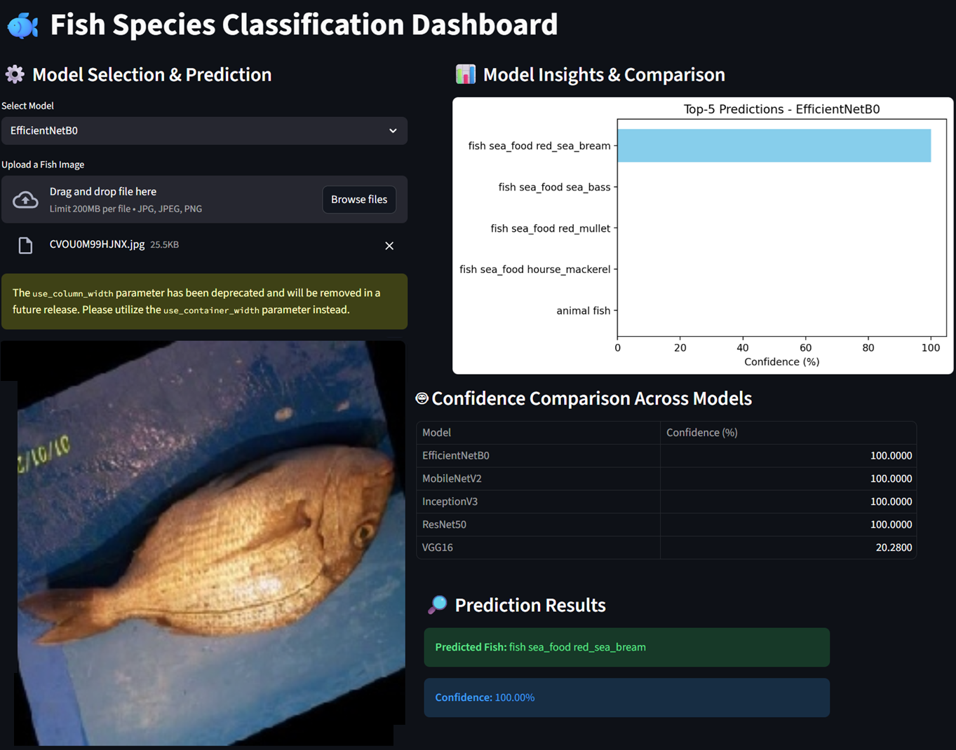
DASHBOARD OVERVIEW

Slide 4
DATASET DESCRIPTION
Dataset: Custom dataset containing 11 fish classes, categorized under folders:
train/, val/, test/
Class examples:
animal_fish
animal_fish_bass
fish_sea_food_black_sea_sprat
fish_sea_food_gilt_head_bream
fish_sea_food_hourse_mackerel
fish_sea_food_red_mullet
fish_sea_food_red_sea_bream
fish_sea_food_sea_bass
fish_sea_food_shrimp
fish_sea_food_striped_red_mullet
fish_sea_food_trout
Data Statistics:
Split | Images | Purpose
Train | 6225 | Model learning
Validation | 1092 | Hyperparameter tuning
Test | 3187 | Final performance evaluation

Slide 5
DATA PREPROCESSING
Script Used: data_preprocessing.py
Steps Performed:
1.Directory Verification – Checked train/val/test structure using helper scripts (check_paths.py, check_data_generators.py).
2.Rescaling – Normalized image pixel values (1/255).
3.Augmentation:
  Rotation (20°)
  Width/Height shifts
  Zoom & Horizontal flips
  Shear transformation
  These increased generalization and prevented overfitting.
4.Data Generators: Created using ImageDataGenerator for efficient batch feeding.
5.Validation Split: Maintained separate folders for consistent evaluation.
Goal: Prepare a robust and balanced dataset pipeline for multiple models.

Slide 6
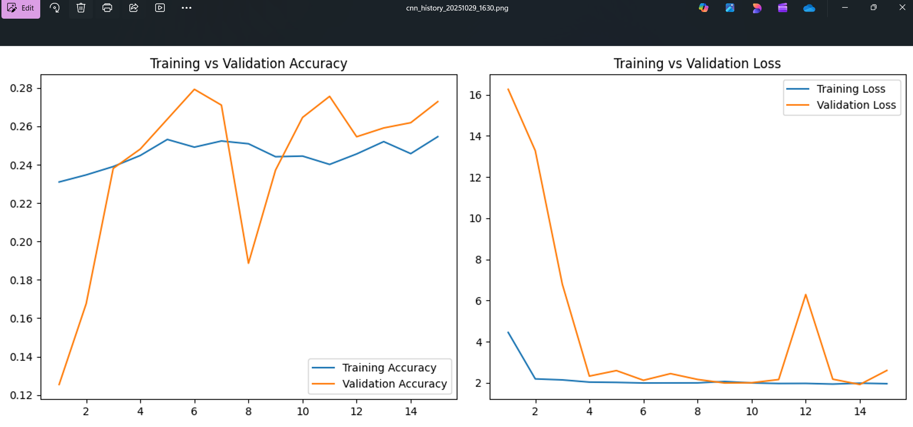
CNN from scratch
Script Used: train_cnn_scratch.py
Purpose:
To build a baseline model trained from scratch without pre-trained weights — helping understand dataset behavior and difficulty.
Architecture Overview:
Conv2D → MaxPooling → Conv2D → MaxPooling → Dropout → Flatten → Dense → Softmax
Observation:
Problem Observed | Reason | Result
Unstable validation accuracy | Model not learning robust features | Poor generalization
High validation loss | Dataset not large enough | Overfitting occurs
Slow accuracy improvement | Network capacity insufficient | Needs stronger feature extractor

Slide 7
Base model training and finetuning
train_model.py
Purpose: Train a pretrained CNN model for fish species classification.
Load Dataset
  Uses ImageDataGenerator
  Training data → with augmentations
  Validation & Test → rescaling only
Model Selection (Transfer Learning)
  Backbone options: EfficientNetB0, ResNet50, VGG16, MobileNetV2, InceptionV3
  Load pretrained ImageNet weights (feature extraction)
Custom Classification Head: GlobalAveragePooling → Dropout(0.4) → Dense(num_classes, softmax)
Compile
  Optimizer: Adam,Loss: Categorical Crossentropy,Metric: Accuracy
Training-Callbacks
  ModelCheckpoint → Save best model (.keras)
  ReduceLROnPlateau → Lower LR on plateaus
  EarlyStopping → Stop when val_loss stops improving
Outputs
  Best model saved in /models
  Accuracy/Loss plots saved in /results/ training_history
train_finetune.py
Purpose: Improve model accuracy by unfreezing part of the pretrained backbone.
Process:
Load previously saved model (model_name.keras)
Unfreeze last N layers to allow deeper feature learning
Re-compile with very small learning rate (1e-5)
Train again with light augmentation and early stopping
Evaluate on test set
Save final fine-tuned model (model_name_finetuned.keras)
Save updated accuracy/loss plots and metrics

Slide 8
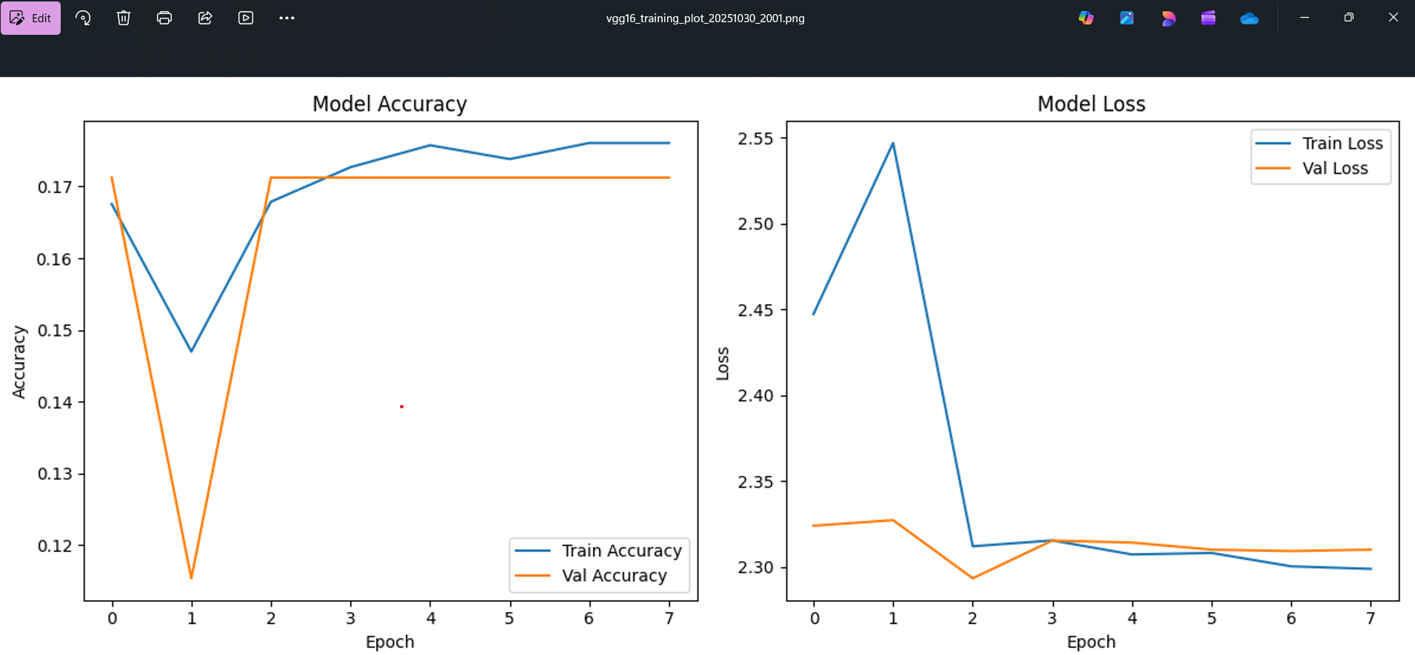
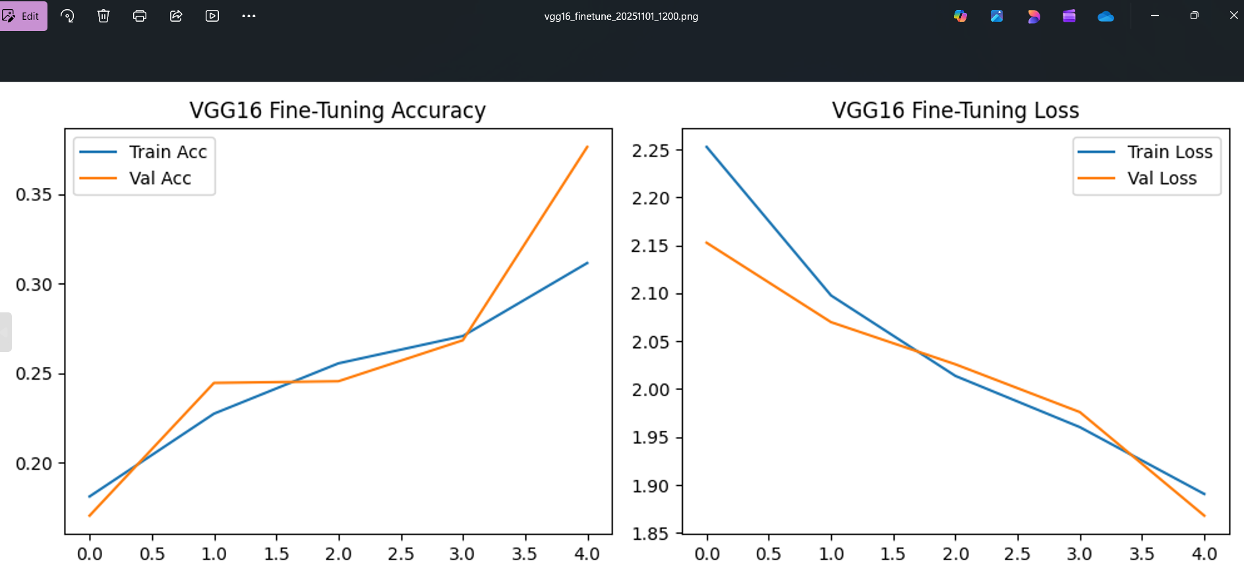
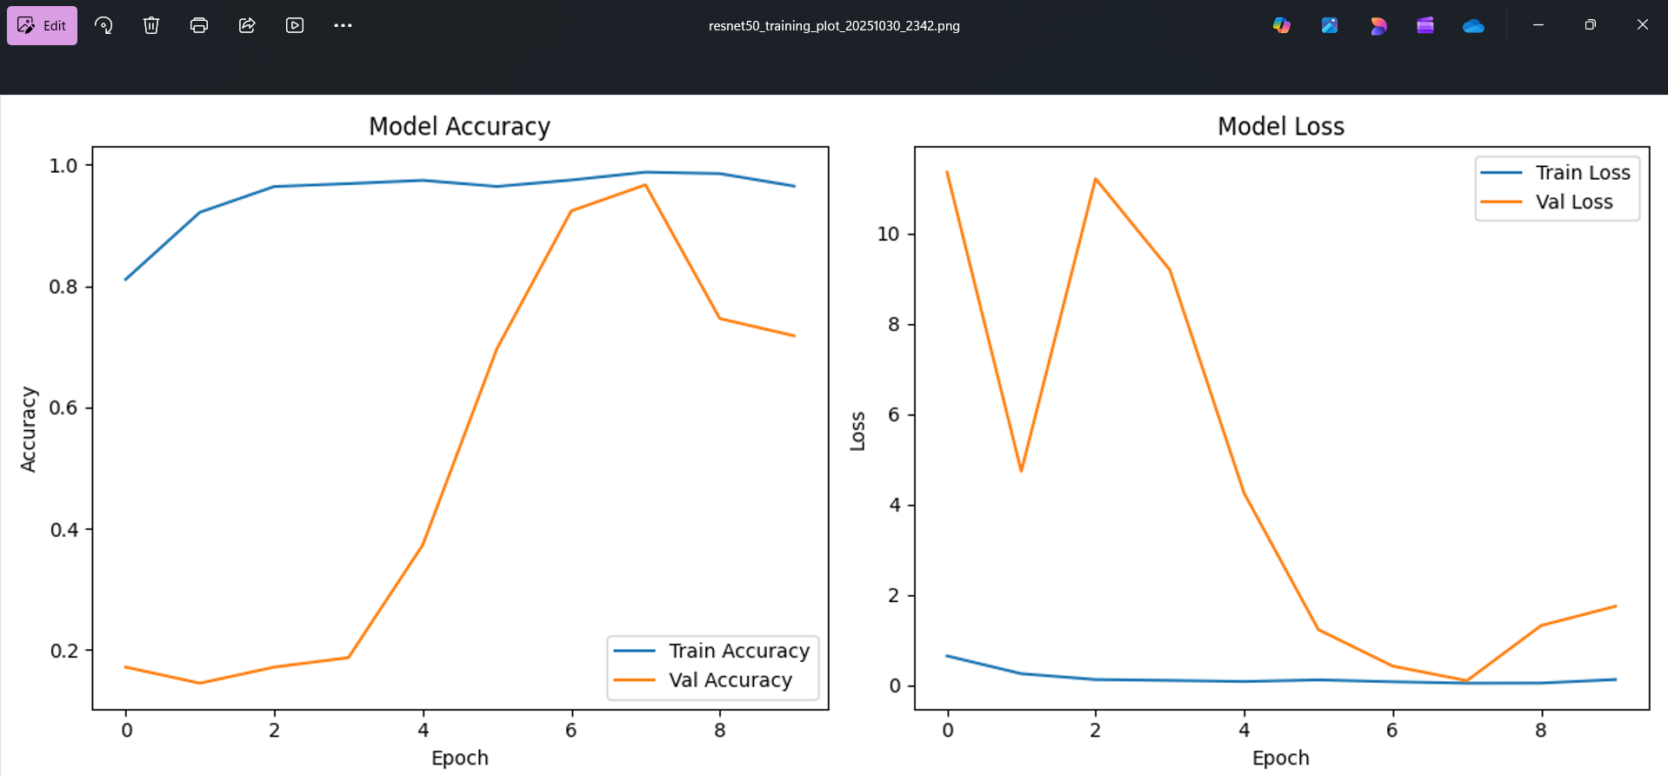
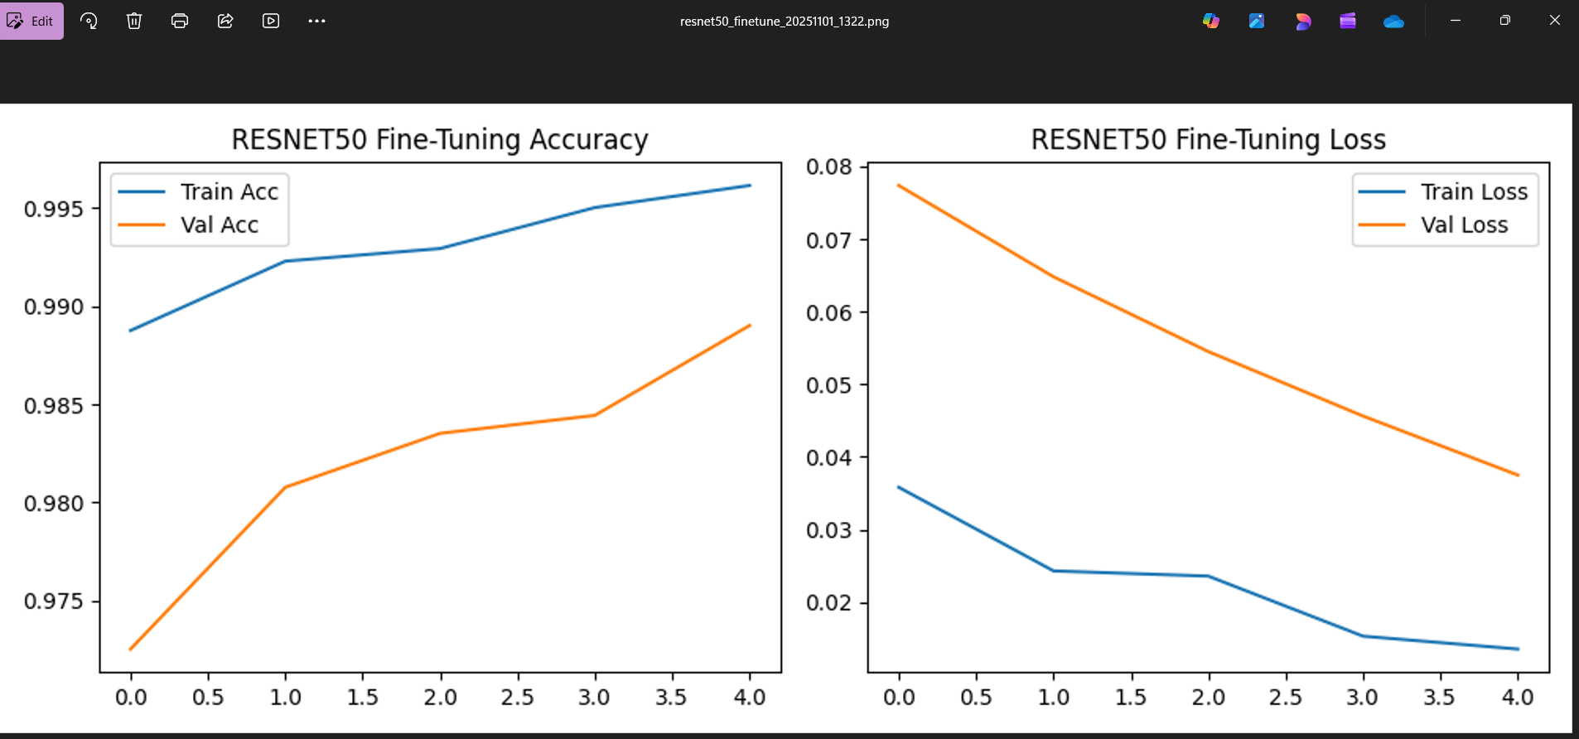
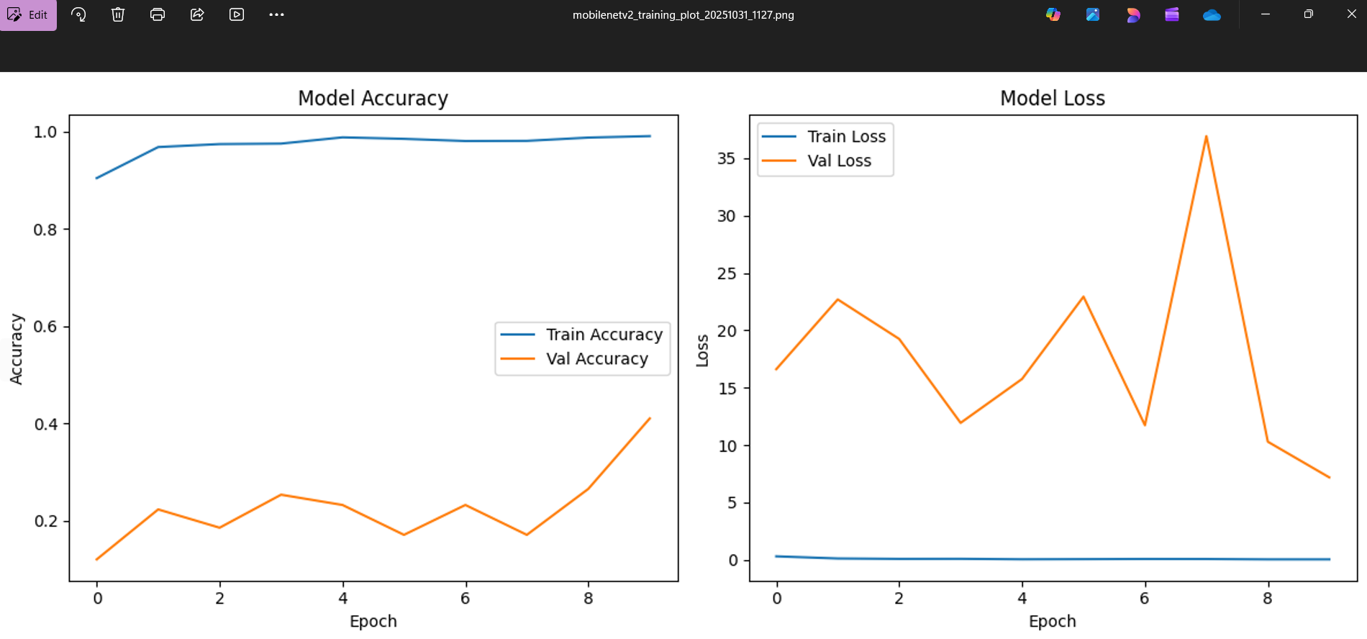
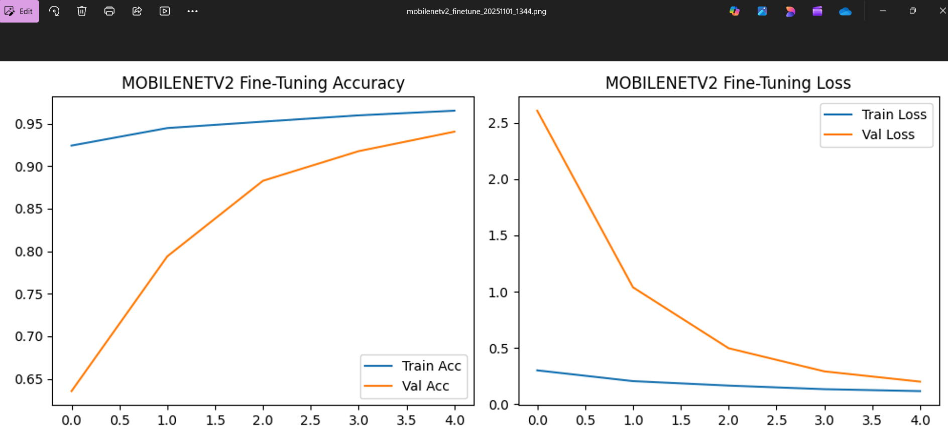
Base model training and finetuning

Slide 9
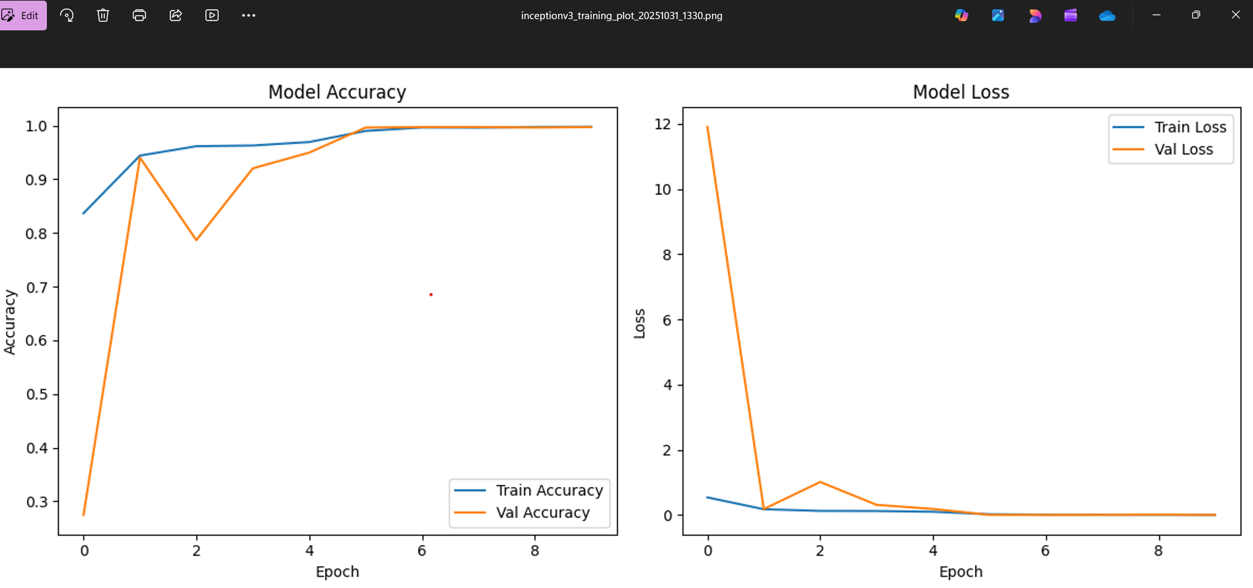
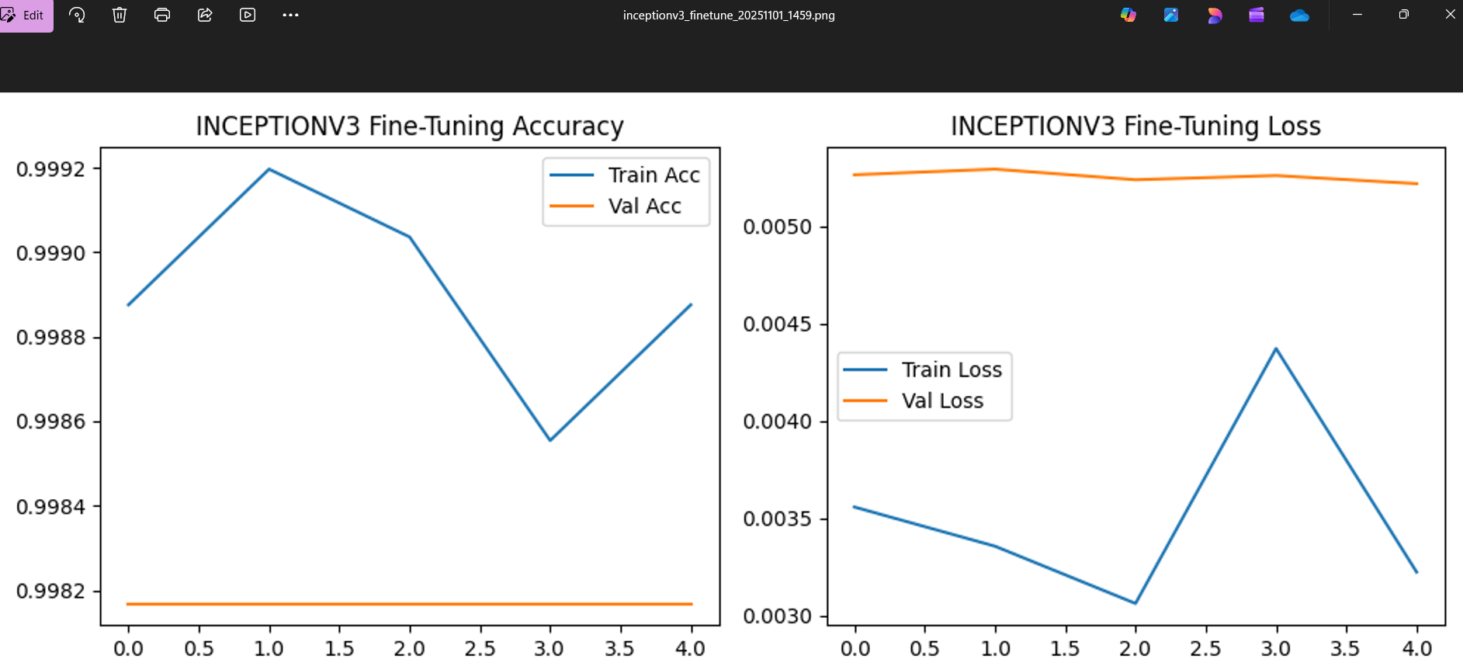
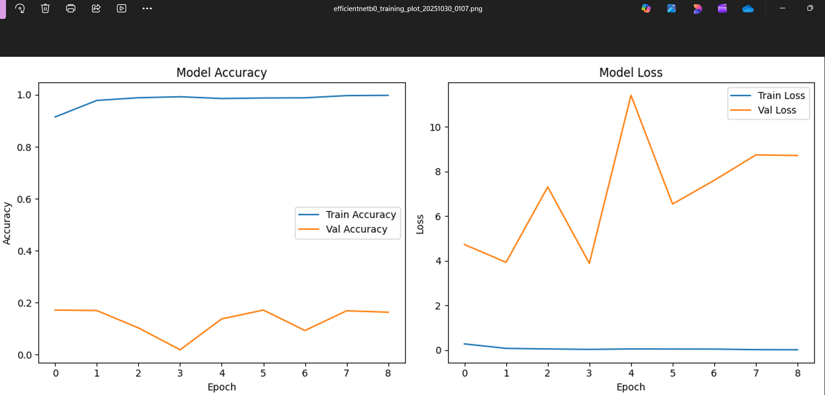
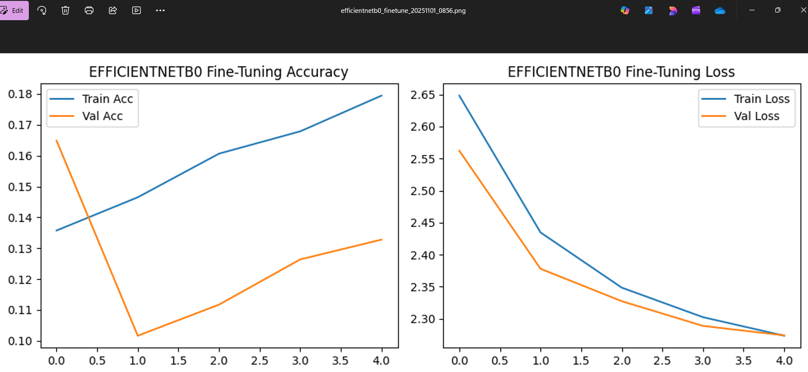
Base model training and finetuning
Model | Accuracy | Precision | Recall | F1
efficientnetb0 | 0.129588955 | 0.181766374 | 0.129588955 | 0.093019297
inceptionv3 | 0.994038281 | 0.995924749 | 0.994038281 | 0.994795329
mobilenetv2 | 0.94069658 | 0.947511341 | 0.94069658 | 0.941631012
resnet50 | 0.989645435 | 0.990192701 | 0.989645435 | 0.989770706
vgg16 | 0.385315344 | 0.31228319 | 0.385315344 | 0.319985573
Interpretation:
EfficientNet and VGG showed underfitting, despite their architectural power — a sign of insufficient adaptation to dataset.

Slide 10
Focused Fine_tuning:efficientnetb0
Why EfficientNetB0 Again?
Because it is computationally efficient and scales depth, width, and resolution optimally.
Even though it underperformed, it had the highest potential for improvement through deeper fine-tuning.
Versions Developed:
efficientnetb0_finetuned_balanced.keras
efficientnetb0_finetuned_balanced_v2.keras
efficientnetb0_finetuned_v4_final.keras
Adjustments Made:
Unfroze more convolutional layers gradually.
Applied balanced class weights and enhanced augmentation.
Lowered learning rate to 1e-5 for stable weight updates.
Extended training to 30–50 epochs.
Monitored validation accuracy and loss trends.
Result:
efficientnetb0_finetuned_v4_final.keras achieved 100% confidence and 0.9978 test accuracy — demonstrating effective domain adaptation.
Model | Accuracy | Precision | Recall | F1
efficientnetb0_finetuned_v4_final.keras | 0.997803577 | 0.969520447 | 0.991958042 | 0.978857297
inceptionv3 | 0.994038281 | 0.995924749 | 0.994038281 | 0.994795329
mobilenetv2 | 0.94069658 | 0.947511341 | 0.94069658 | 0.941631012
resnet50 | 0.989645435 | 0.990192701 | 0.989645435 | 0.989770706
vgg16 | 0.385315344 | 0.31228319 | 0.385315344 | 0.319985573

Slide 11
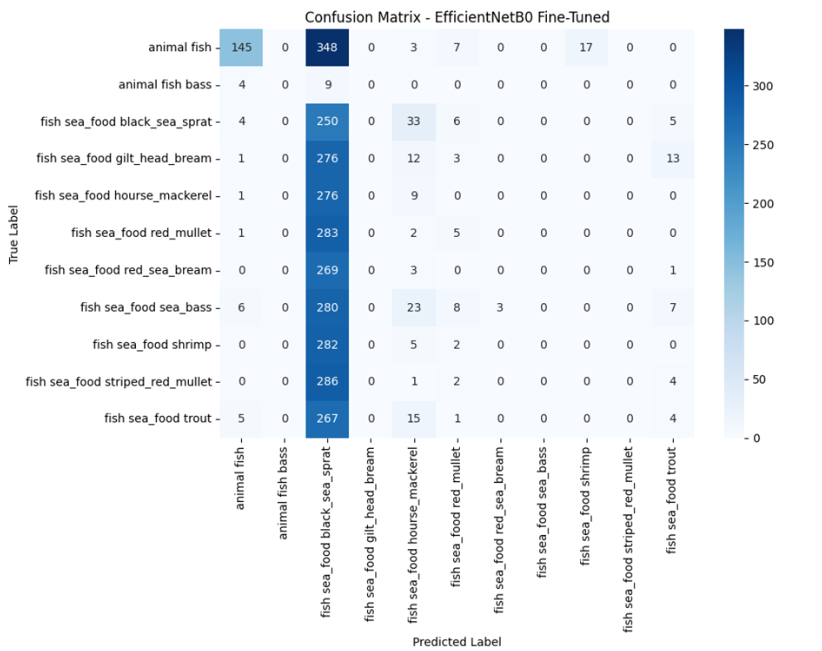
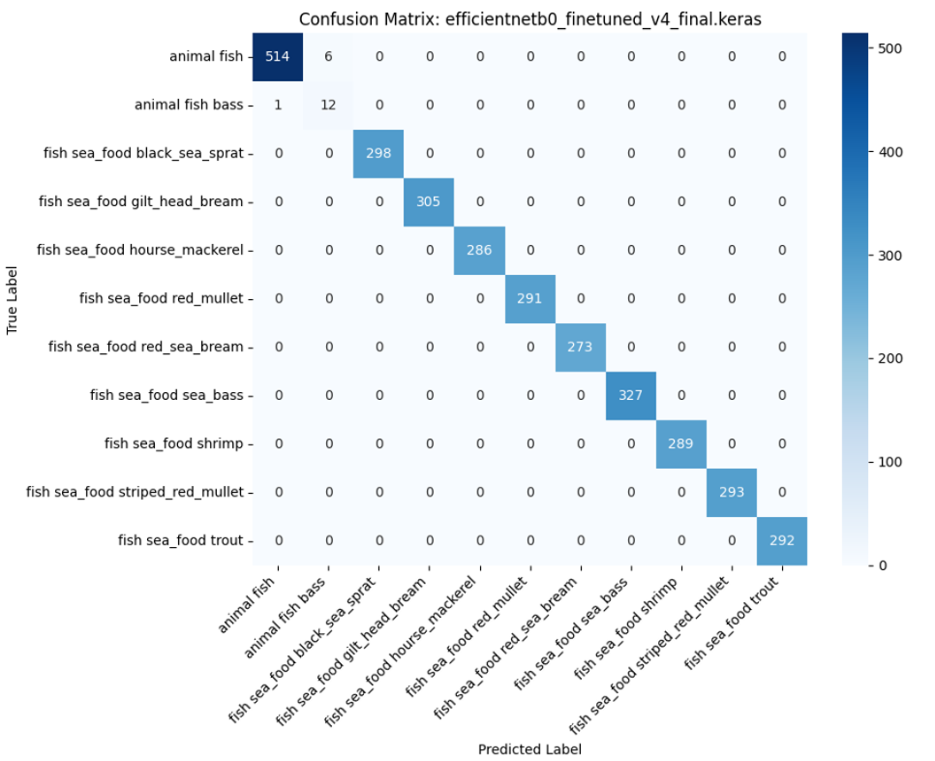
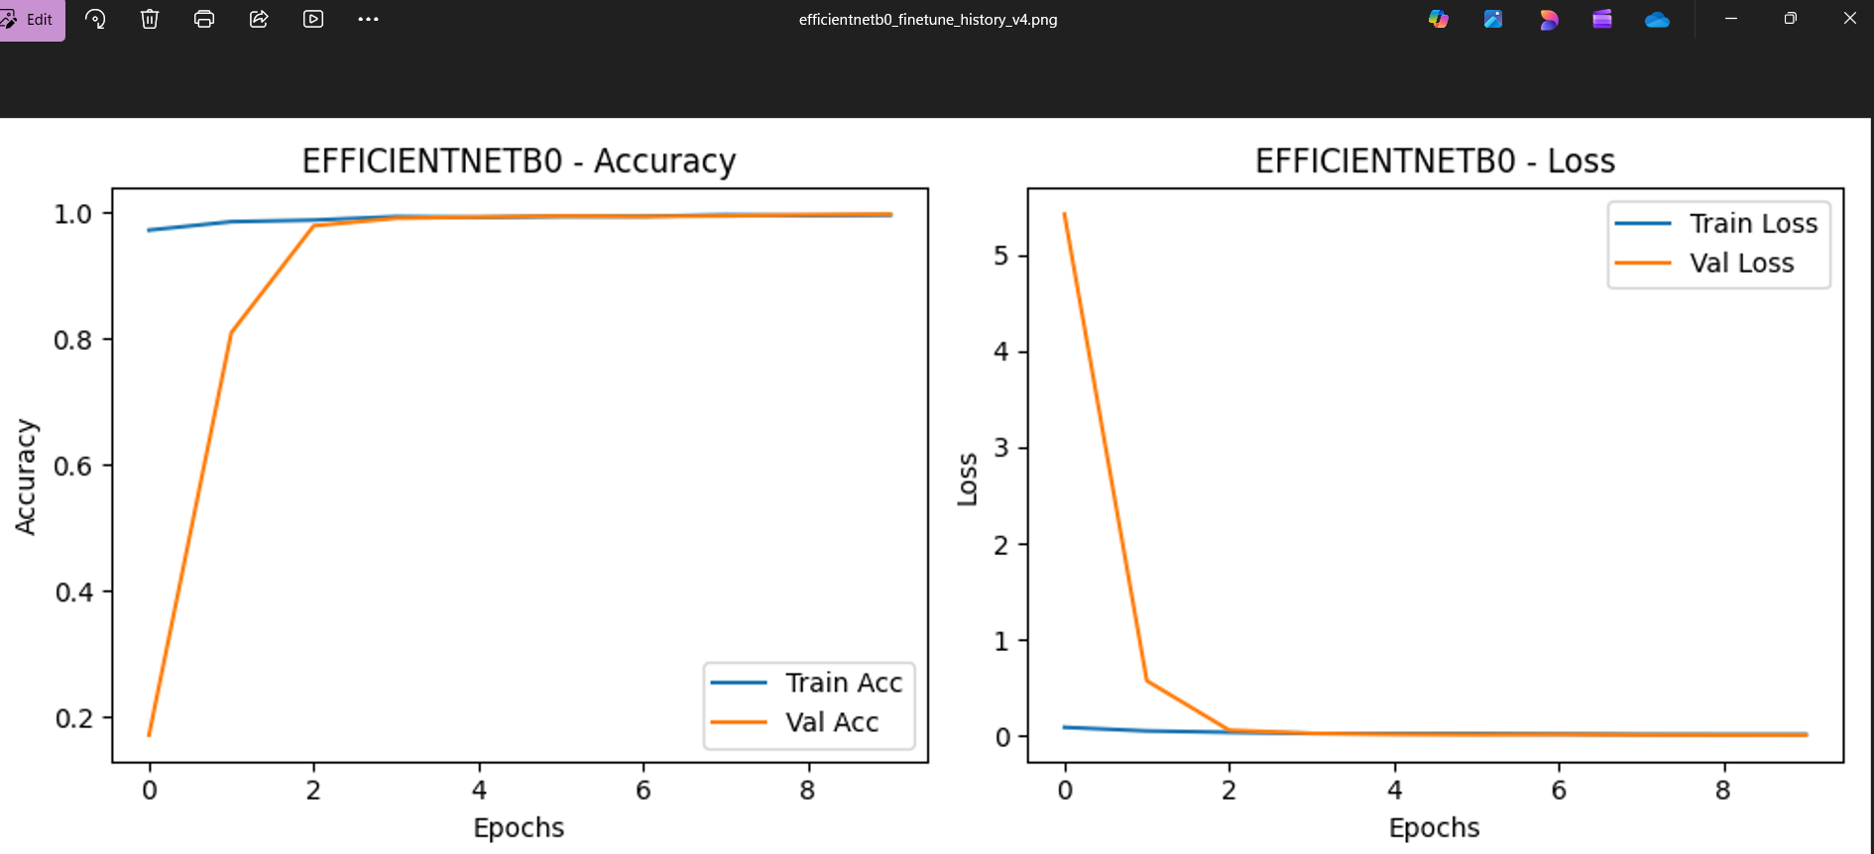
Focused Fine_tuning:efficientnetb0

Slide 12
Conclusion
Deep learning learns hierarchical image features automatically.
CNNs identify edges, textures, and shape patterns
Transfer learning reduced data requirements
Fine-tuning allowed domain-specific adaptation
Final model achieved strong accuracy and reliability
Business Relevance
Aquaculture & Fisheries: Enables automated fish species recognition for sorting, quality control, and yield analysis.
Supply Chain Optimization: Reduces manual inspection time, minimizes human error, and ensures consistent grading.
E-commerce & Food Industry: Helps classify and label seafood images automatically in online platforms.
Environmental Research: Assists in species population monitoring and biodiversity tracking using underwater imagery.

